Slide 1
USF IRB Submissions
Jamie Reddish, MPH
Research Compliance Administrator

Slide 2
Overview
Initial Applications
Record, Chart, or Dataset Review
Tips
Record, Chart, or Dataset Review
Waiver of Informed Consent
Risk & Benefit Assessment
Privacy and Confidentiality
Waiver of HIPAA authorization
Data Monitoring Plan
Continuing Reviews
Amendments
Reportable Events

Slide 3
Starting an Application
Familiarize yourself with protocol and data collection sheet
Read each question thoroughly
Answer all parts of each question
If not applicable, please explain
Consistency with protocol, application, and data capture sheet.
Be careful with “Copy and paste”
Version number and date in document and title

Slide 4
Record, Chart, or Dataset Review
5.3.1 Please provide the source or identify the location of the data
Please include the actual name of the database (EPIC, Allscripts, etc.)
Outside database (provide more information in the protocol)
5.3.3 How will you determine which charts/records/datasets to review (e.g. by year, by diagnosis, etc.)?
The answer will be repeated several more times, so be consistent. (9.1b.4 and 9.1b.4c)

Slide 5
Record, Chart, or Dataset Review
5.3.4 Number of charts/records/datasets you will review (this number should include the total number of records to be reviewed, not just those from which data will be extracted):
Consistent with the protocol and also include the number of charts that will not meet inclusion criteria.

Slide 6
Record, Chart, or Dataset Review
5.3.5 Please attach your data capture sheet (data collection form) or a document that includes the variables you will collect to answer your question(s).
Will there be any PHI on the data collection sheet (dates).
Will there be a “Master Sheet”?
Will all data be collected on one sheet?

Slide 7
Waiver or Alternation of Informed Consent Process
7.4.1 Please describe how your research involves no more than minimal risk to subjects:
7.4.2 Please describe how the waiver or alteration will not adversely affect the rights and welfare of subjects:
7.4.3 Please describe how the research cannot practically be carried out without the waiver or alteration of informed consent:
7.4.4 Will participants be provided with additional, pertinent information after participation in the study:

Slide 8
Risk & Benefit Assessment
8.1.2 Describe the risks associated with each intervention or study procedure. Include consideration of physical, psychological, social, and other factors. If data is available, estimate the probability that a given harm may occur and the potential reversibility. For Record Reviews, address risk of breach of confidentiality:
8.1.3 Describe the safety precautions that will be taken to minimize risks/harms:
The answer to this question will be repeated several times in the application. (9.1.3, 9.1.4, ~9.1.5~)

Slide 9
Privacy and Confidentiality
Privacy is the control over the extent, timing and circumstances of sharing oneself (physically, behaviorally or intellectually) with others.
Confidentiality refers to the treatment of information that an individual has disclosed in a relationship of trust, with the expectation that it won’t be divulged to others without permission.
Detailed description of how the data will be stored.

Slide 10
Privacy & Confidentiality
9.1.3 Describe the steps that will be taken to protect the privacy of participants during the conduct of the research:
9.1.4 Describe how the data (including informed consent documents) will be kept confidential during collection, analysis, and storage. Address both physical and electronic records:
Sections 9.1.3 and 9.1.4 answers can be similar (remember section 8)

Slide 11
Privacy & Confidentiality continued…
9.1.5 How and where will the data be stored? How long will data be kept ( See Requirements ) and how will it ultimately be destroyed?
Tip: “USF IRB requires data to be stored for 5 years after the final report has been submitted”.
9.1.8 Will you use, receive, review and/or disclose protected health information (PHI) in the course of conducting this research?
Yes No

Slide 12
HIPAA Waiver or Alteration: PHI Source, Access, Disclosure
9.1b.1 Please describe the PHI that you plan to access, use, or create/collect (e.g., Are you accessing or using medical records, pathology records, databases, or a similar source containing PHI?):
What identifiers are you collecting? (Consistent with section 9.1b.2 [table])
9.1b.2- Mark all that apply.

Slide 13
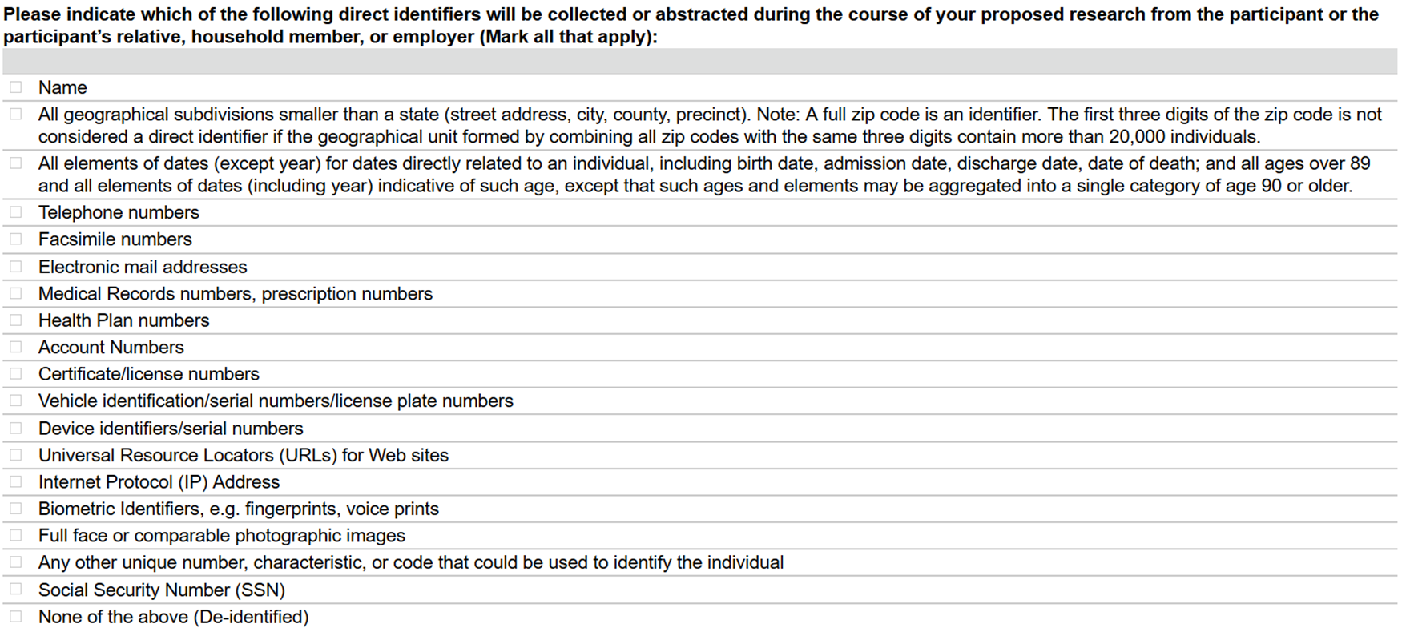

Slide 14
HIPAA Waiver or Alteration: Minimal Risk to Subjects' Privacy
9.1c.1 Describe the plan to protect the identifiers from improper use and/or disclosure:
Where will the identifiers be stored?

Slide 15
HIPAA Waiver or Alteration: Minimal Risk to Subjects' Privacy
9.1c.2 Describe your plan to destroy the identifiers (including any list you created during the course of the performance of your research which contained identifiers) at the earliest opportunity consistent with the conduct of the research:
When will the identifiers be destroyed?

Slide 16
HIPAA Waiver or Alteration: Authorization Impracticability
9.1d.1 Please explain why it is not practicable to obtain individual HIPAA Authorizations from the participants before using or disclosing their PHI in your study (i.e., Why you must have the HIPAA Waiver to conduct this study?):

Slide 17
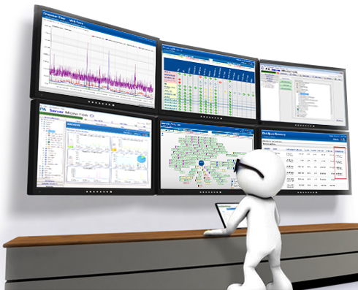
Data Monitoring Plan
10.1.1 Describe your plan for ensuring the integrity of the data you collect, including how often you plan to monitor the data:

Slide 18
Continuing Reviews

Slide 19
CR Question
1.6.1- Summarize the current research activities including long term follow-up and/or any interim findings and their impact on participants' willingness to continue participation since the last IRB review
Ensure that this section is fully answered with a description of current research activities including follow-up. The Board likes to see a breakdown of numbers (e.g. 1 subject in screening, 3 on treatment, 4 in follow-up, etc).
Ensure that the numbers in 1.6.1 correlate with the numbers in 6.1.1/2 (number consented), 6.1.3a (screen fails), and 6.1.4a (withdrawals/drops).

Slide 20
CR Question
1.6.4- Attach a copy of any relevant multi-center trial reports, including the most recent data and safety monitoring report, if not previously submitted to the IRB via a Reportable Event:
Upload any DSMB reports not previously reported to the IRB in this section. If you explain in section 10 that the DSMB met on a specific date, a report should be provided if it wasn’t already submitted as a reportable event.
Please note: IRB checks section 10 of the application to ensure the approved plan is followed.

Slide 21
CR Questions
6.1.1- Number of records reviewed and/or specimens collected
If the study is not strictly a record review/specimen collection, leave blank. To answer this as 0 is not usually accurate, as drug trials typically have a specimen collection component.

Slide 22
CR Question
7.1.3 If you are obtaining signed consent and have enrolled participants since the last IRB review, please upload a copy of the two most recently signed informed consent/assent documents.
Please ONLY redact the participants' identifiers (name, signature, etc.) from the signed consent forms.
Please do not cover either dates. Also, using a post-it is efficient in redacting.

Slide 23
CR Question
Ensure that your responses in section 7 explain how the informed consent process was implemented and the actions that were taken to ensure subjects understood the research, not how you plan to implement the process/how you will ensure subjects understand.

Slide 24
CR Questions
10.1.1 Describe how frequent the data was monitored. Please provide reasoning if it was monitored less frequently.

Slide 25
SAE Log @ CR
Ensure that the SAE log includes withdrawals/drops that were due to a SAE, including deaths.
If you report that a subject was withdrawn because they expired, the Board will want to see details of that death.

Slide 26
Noncompliance @ CR
When at Continuing Review, update the Protocol Deviation Log*, with Non-Compliance.
*Although non-compliance may not be a deviation from the protocol, this is the best and easiest way for you to notify the IRB.

Slide 27
CR Consenter
When receiving the last two signed consent forms, check the consenter and when were they added (if at all) to the IRB application.
If they were added after they have consented subjects, add to deviation log.

Slide 28
Re-consent @CR
Closed to enrollment but need to re-consent subjects?
Please include this is the continuing review.
(Example: NOTE TO IRB…)

Slide 29
Amendments

Slide 30
Change @ Amendment
In the Amendment Request page
1.0 select ‘Other Changes’
Click continue to update each applicable section.

Slide 31
Amendment
2.0 of the Amendment Request page
Describe and justify all changes made, even minor changes such as addition/removal of study staff
Note: this section pulls into the approval letter.

Slide 32
Amendment
Changes to the Consent Document?
Check approval letter if re-consenting is required.
After the initial/revised English consent has been approved, submit the initial/revised translated document, via an amendment, in a timely manner.

Slide 33
Reportable Event

Slide 34
The corrective action plan should include the following information (as applicable):
An assessment for why the error took place
Details of the process change
Who is involved in the change
When the change will be implemented
How will the new procedure (change) be taught to the study team
How will the change be assessed for improvement down the road

Slide 35
Approval Letters
Please read all approval letters.
Examples of things that could be contained in an approval letter:
Re-consent (active or all participants)
Submit a Reportable Event (time frame)
Submit an amendment (time frame)

Slide 36
Contact Information
Jamie Reddish jreddish@usf.edu 813-974-5741
Nancy McCormick mccormickn@usf.edu 813-974-8553
Anna Sladky asladky@usf.edu 813-974-7486

Slide 37
Contact Information
Jamie Reddish, RCA jreddish@usf.edu 813-974-5741
Nancy McCormick, IRB Manger mccormickn@usf.edu 813-974-8553
Anna Sladky, RCA/ HIPAA Reviewer asladky@usf.edu 813-974-7486

