Slide 1
A Glimpse into an ACGME Next Accreditation System Site Visit – What to Expect and How to Prepare
Jillian Atherton, Ph.D.-ABD
Michael King, MD, MPH
University of Kentucky
Department of Family & Community Medicine

Slide 2
Objectives
Describe updated ACGME requirements, processes and activities of the NAS
Review organizational and logistical strategies to prepare faculty and residents for an ACGME site visit in the (NAS).
Develop an “aim” goal for your program, and learn how to integrate this into your site visit dialogue, using Brofenbrenner’s Ecological Systems model
Review ACGME pre- site visit data requests
Notes:
Feedback on NAS requirements (CCC, PEC, etc.)

Slide 3
What are we leaving behind?
PIFs
IRDs, Institutional Review Documents
Short-cycle site visits
Internal Reviews
Site Visitor Documentation Checklists
Familiarity, comfort, the system we have known.
Notes:
Feedback on NAS requirements (CCC, PEC, etc.)

Slide 4
New Accreditation System Changes
Program Accreditation
ACGME data reporting
Milestones Assessment & Reporting
Program Self-Study Visits
Institutional Accreditation
Institutional Self-Study Visits
CLER visits
Hospital by hospital on-site systems visits
Notes:
Feedback on NAS requirements (CCC, PEC, etc.)

Slide 5
Perspectives to Consider with NAS changes…
Resident
Chair
Program Director/ Assoc. Program Director
Faculty
Hospital Administration
GME Office
Program Coordinator
Notes:
Feedback on NAS requirements (CCC, PEC, etc.)

Slide 6
Changes will occur from…
ACGME
New ACGME webADS survey
Published Milestones
New Institutional requirements
ACGME/AOA unified accreditation
Notes:
Feedback on NAS requirements (CCC, PEC, etc.)

Slide 7
Program Self-Study & Improvement
ACGME self-study visits began July, 2014
Internal Reviews
No longer required as of July, 2013, but may still be helpful
Not necessary for accreditation, but do if necessary
Tool for program improvement, NOT A PIF
Ongoing goal-setting for long-term: 3-5 years
Consider SWOT (strengths/weaknesses/opportunities/threats/stakeholders
Will discuss later in handout
Consider program outcome trends
Annual Program Review is REQUIRED!
Notes:
Feedback on NAS requirements (CCC, PEC, etc.)

Slide 8
Program Self-Study & Improvement
ACGME self-study visits began July, 2014
Internal Reviews
No longer required as of July, 2013, but may still be helpful
Not necessary for accreditation, but do if necessary
Tool for program improvement, NOT A PIF
Ongoing goal-setting for long-term: 3-5 years
Consider SWOT (strengths/weaknesses/opportunities/threats/stakeholders
Will discuss later in handout
Consider program outcome trends
Annual Program Review is REQUIRED!
Notes:
Feedback on NAS requirements (CCC, PEC, etc.)

Slide 9
Program Self-Study & Improvement
Notes:
Feedback on NAS requirements (CCC, PEC, etc.)

Slide 10
Program Self-Study & Improvement
Two Main Objectives:
Assess the program’s current status and compliance with relevant requirements
Review the record of improvement made since the last accreditation review
Notes:
Feedback on NAS requirements (CCC, PEC, etc.)

Slide 11
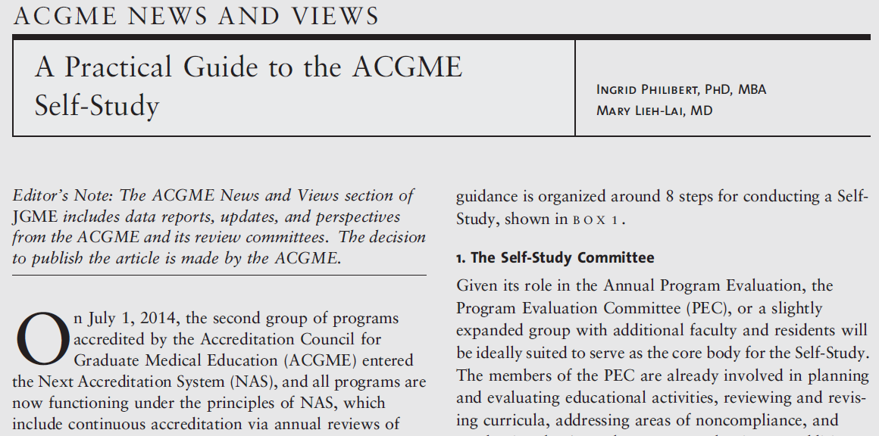
Notes:
Feedback on NAS requirements (CCC, PEC, etc.)

Slide 12
Collecting Annual Data
Annual ADS Update
Board Pass Rate
Clinical Experience
Resident Survey
Faculty Survey
Semi-Annual Resident Evaluation and Feedback
Milestones
Clinical Competency Committees
Hospital-wide CLER Visits: Patient Safety/QI
Program Citations
Program Evaluation Committees
Notes:
Feedback on NAS requirements (CCC, PEC, etc.)

Slide 13
Preparing for Annual Data Collection
Annual ADS Update
Board Pass Rate
Clinical Experience
Resident Survey *
Faculty Survey*
Semi-Annual Evaluation of Milestones
CLER Visits
Monitoring Program Citations
Track locally before submission
Track locally
Procedure logs
Administer via E-system
Administer via E-system
Evaluations
Data collected
PEC minutes/Citation Status Updates
* Very similar questions
Notes:
Feedback on NAS requirements (CCC, PEC, etc.)

Slide 14
Self-Study Visit: Why would we volunteer?
ACGME NAS (New requirements)
Extended accreditation
PC (3 years)
Admin. Assoc. (2 years)
PD (6 years)
Assoc. PD (3.5 years)
Notes:
Feedback on NAS requirements (CCC, PEC, etc.)

Slide 15
Process
PC sought approval from PD
PC confirmed interest with GME
GME/PC reached out to ACGME
Visit scheduled
Pre-visit date request items submitted to ACGME
Pre-visit scheduling with ACGME completed
Pre-visit meetings with residents/faculty completed
Visit occurs
Report delivered from ACGME
Notes:
Highlights in RED will be discussed in more detail in later slides

Slide 16
Pre-Visit Data Requirements (see SWOT handout)
ACGME “Submit a list about your program, using feedback regarding the following categories:…” (SWOT)
Strengths
Areas for Improvement
Opportunities
Threats
Residents must be part of feedback process
Notes:
Only form sent to us from ACGME to disclose nature of content to be questioned/discussed at site visit; useful to compile feedback from residents/faculty, in advance of meeting
S/w residents confidentially submitted
Be prepared to answer questions about all 4

Slide 17
Pre-Visit Scheduling
Make sure all participating residents/faculty/GME staff are available for day of site visit (clear clinic/call schedules)
Reserve all rooms
Accessibility to laptop (display management system, i.e. Medhub, New Innovations, etc.)
Select your highest quality resident portfolios
Have policies/procedures/handbooks accessible
Have PEC meeting minutes available
Catering
Notes:
Review navigating through Medhub prior to site visit to make sure you can locate high yield site visit material

Slide 18
Pre-Visit Meeting with Residents and Faculty
Review last few years of APE
Review issues of Resident/Faculty Surveys
Especially persistent noncompliant areas
Review last accreditation report, including citations
Meet with each group, separately
Agenda:
Generate/discuss SWOT handout
Reminders about common program requirements
Notes:
Have a somewhat similar discussion with residents/faculty as done prior to Resident/Faculty Survey

Slide 19
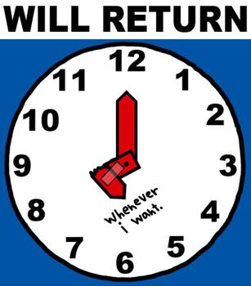
Visit
8am – 1pm
Introductions & Briefing (20mins)
PD Briefing (40mins)
Resident Interview (50mins)
Faculty Interview (45mins)
Document Review and Coordinator Interview (45mins)
Program Director Interview (45mins)
Site Visit Debriefing (45mins)
Take a long, deserved lunch break
Notes:
PC interview included a lot of questions about my opinions regarding 4 categories
Good CCC feedback
Will talk about the nature of questions asked in later slide

Slide 20
ACGME Report
Wait for it…Wait for it…received report from ACGME approximately 1 month after visit
10 pages long (single-spaced)
Categories summarized from PD, Resident, Faculty, and Reviewers perspective
Notes:
Nothing new; so surprises
Great feedback
Reiteration of 4 categories from the perspective of faculty, residents, PD, and site reviewers (all areas were in alignment per category)

Slide 21
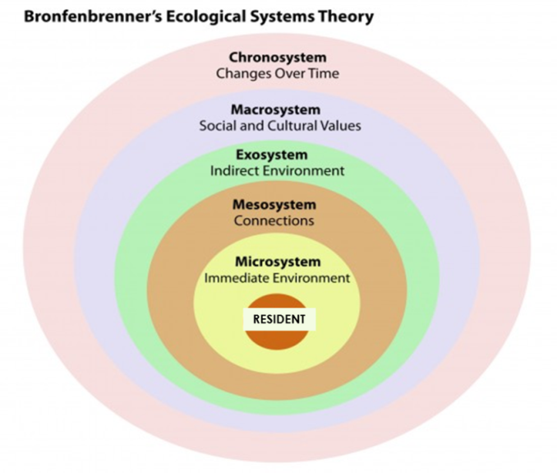
Takeaways
First question was, “What is the aim of your program?”
Subsequent questions appeared to follow Brofenbrenner’s Ecological Systems Model
Notes:
Resident: generational values
Microsystem: FM Department, FM Faculty, PD, Assoc. PD, Inpatient/Outpatient service, Global Health and Sports Medicine Tracks
Mesosystem: UK, GME, Other UK rotations
Exosystem: Off-site rotations, Community, Other national FM programs, trends/systems, media
Macrosystem: Laws, History, Healthcare, Culture, Attitudes
Chronosystem: Time, Patterns occurring over time, Events

Slide 22
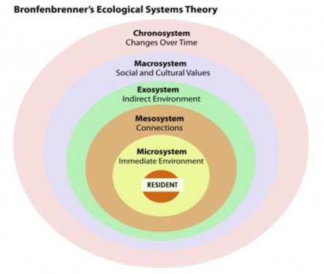
Ecological Systems Model
Resident: generational values
Microsystem: FM Department, FM Faculty, PD, Assoc. PD, Inpatient/Outpatient service, Global Health and Sports Medicine Tracks
Mesosystem: UK, GME, Other UK rotations
Exosystem: Off-site rotations, Community, Other national FM programs, trends/systems, media
Macrosystem: Laws, History, Healthcare, Culture, Attitudes
Chronosystem: Time, Patterns occurring over time, Events
Notes:
Resident: generational values
Microsystem: FM Department, FM Faculty, PD, Assoc. PD, Inpatient/Outpatient service, Global Health and Sports Medicine Tracks
Mesosystem: UK, GME, Other UK rotations
Exosystem: Off-site rotations, Community, Other national FM programs, trends/systems, media
Macrosystem: Laws, History, Healthcare, Culture, Attitudes
Chronosystem: Time, Patterns occurring over time, Events

Slide 23
Takeaways
Close attention paid to the context of each program and the specialty (what are the unique intricacies of your specialty?)
Be open, honest, and prepared to talk about what makes your program great, and what plans are in place to address areas for improvement
Previous citations will be discussed – have an update ready to share
Goal: residents/faculty/PD/PC all need to be saying the same thing during break-out groups; all need to be on the same page, regarding program SWOT
Reviewing APE, policies, common program requirements, and SWOT list with faculty and residents, in advance, helps keep everyone on same page.
Notes:
-ACGME recognized the granularity of processes related to FM program (ie. numerous rotation sites)
-No bean counting (left for WebADS)

Slide 24
Takeaways
Questions include Program SWOT, CCCs, PECs (& Curriculum), Residents, Faculty, University System, GME
Have a few great resident portfolios ready to share and answer questions.
UK CCC: “Focus feedback to resident to include specifics about how to improve within competencies, rather than what they’re currently doing and/or not doing.”

Slide 25
“To-Do” List
Engage department (milestones) and hospital administration (CLER)
Faculty Development (milestones)
Define and select core faculty
Optimize annual update and board scores
Learn as much about milestones
Continue improving your CCC processes/feedback
Continue improving your PEC processes
Develop a self-study and strategic plan

Slide 26
Questions?
Michael King, MD,MPH, FAAFP
Residency Program Director, Associate Professor
Department of Family & Community Medicine, University of Kentucky
K302 Kentucky Clinic, Office K344, Lexington, KY 40536-0284
Office: (859) 323-5264
Cell: (859) 533-0426
mrking02@uky.edu
@MR7King
@UKFamilyMed
UK Family Medicine Residency
Website: http://www.mc.uky.edu/familymedicine/prospective.asp

