Slide 1
Making Milestone Mountains into Molehills
Data management
And
The ACGME Milestones

Slide 2
Overview and Objectives
Objectives:
Understand the “volume” of data with milestone assessment
Review successes/failures with Milestone data management experience
Assess methods to increase efficient presentation of milestone data to your CCC

Slide 3
Into the milestones
In the beginning
There were 12….
Just 12.
Very simple (said the Radiology RRC)

Slide 4
Or is it…
Doing the math
12 Milestone sections
6 rotations
At least 6 evaluators
Compound this by
32 residents

Slide 5
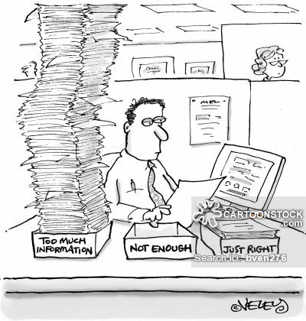
Managing the “Milestone” data
Challenges for all Program Directors:
Lots of data
Not much time
CCC members
Volunteers
Incentives (or lack thereof)

Slide 6
So, where to start
Residency data management system
Data
Storage
Management
Clearinghouse

Slide 7
Diving into New Innovations
I set out to find… the EFFICIENT MILESTONE EVALUATION…

Slide 8
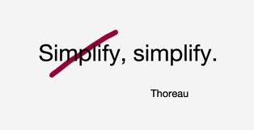
My initial solution
MONTHLY EVALS =
MILESTONES

Slide 9
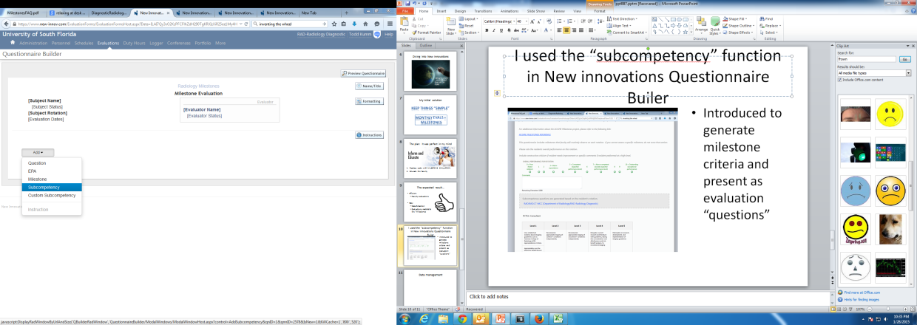
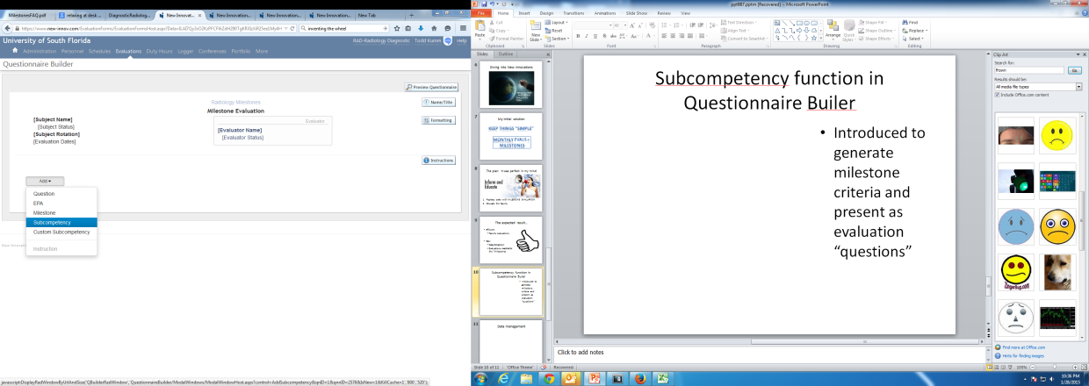
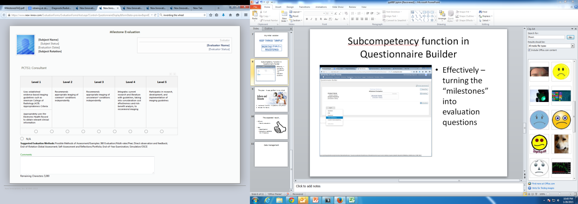
Subcompetency function in Questionnaire Builder
Effectively – turning the “milestones” into evaluation questions

Slide 10
The plan: It was perfect in my mind
Implement Monthly - MILESTONE EVALUATION
Educate the faculty

Slide 11
The expected result…
Efficient
Faculty evaluations
Easy
Data Extraction
Evaluations matched to the “Milestones

Slide 12
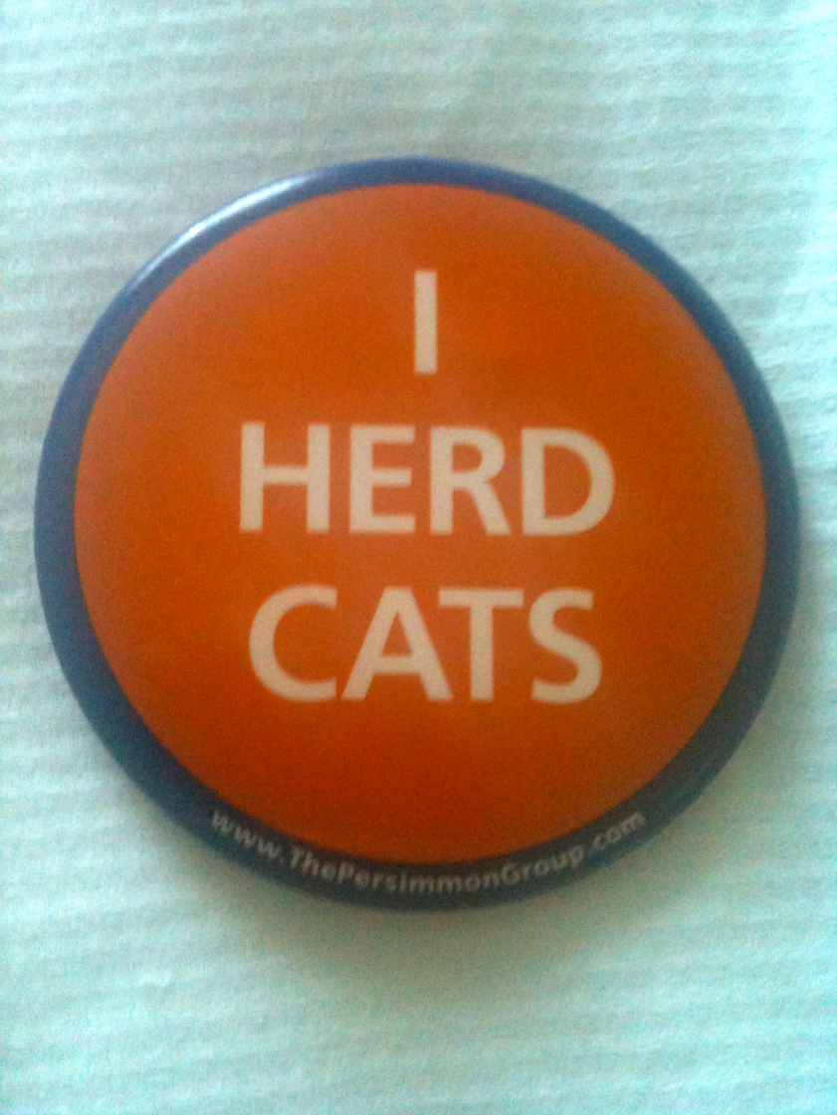
The reality…
Faculty fell into old habits:
The “beginner” to “expert” concept was not uniformly embraced
“N/A” response was far too frequent
Feedback was not positive

Slide 13
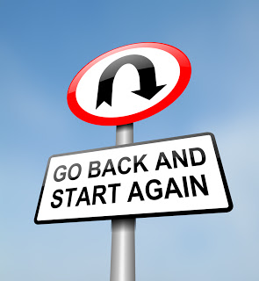
Milestone evaluations, 2.0
Reviewed results with to the CCC
Updated evaluations with milestone-ish questions
Applicable
More like prior form

Slide 14
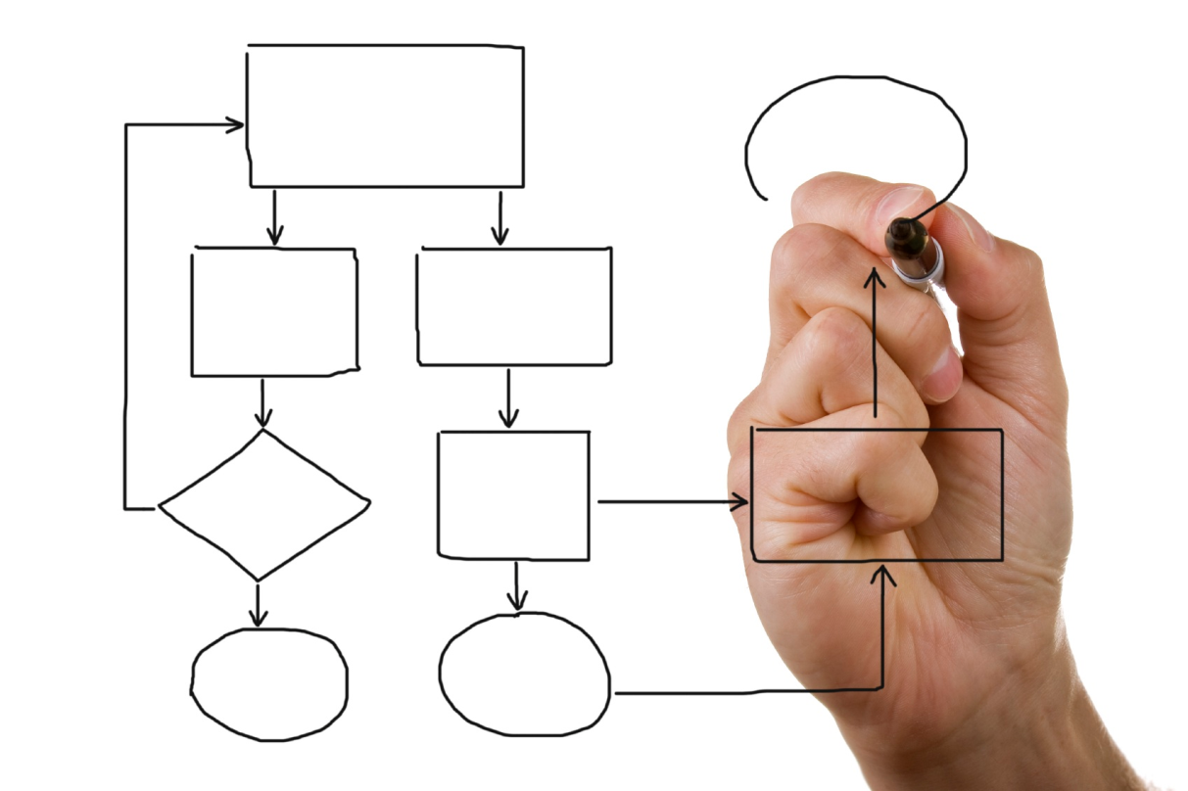
New Innovations & Milestones 2.0
Evaluation “reports”
Milestone “mapping”

Slide 15
Evaluation Reports in NI
Evaluation reports
Text display of evaluation reports

Slide 16
Evaluation reports
Using evaluation reports to distill data
Summary of rotation evaluation results

Slide 17
Evaluation reports

Slide 18
Pros and Cons of Evaluation reports
Pros
Cons
Very easy to use
No set up
Easy to understand
No “trend” data
Printouts usually required

Slide 19
What is “Milestone” mapping
Evaluation questionnaire function
Matches or “maps”
Evaluation questions to milestone summary data

Slide 20
Interface for recording the milestone score
Graph of the evaluation scores for the resident

Slide 21
Question mapping in NI
PROS
CONS
“Built in” to new innovations
Graph display of rotation scores
Some basic trend data
Comments displayed
“Click” heavy
Lacking some efficiency
Missing
Logs
Research

Slide 22
So what is your goal
Efficient data display and distribution
Getting the data to the CCC
Organized
Trend evaluation
Identification of outliers

Slide 23
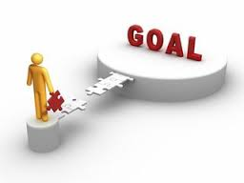
Aspirational goals
Maximizing efficiency
Getting the Milestone data into “one page”

Slide 24
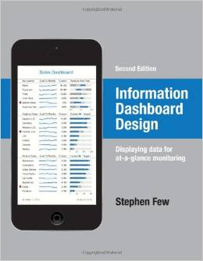
Dashboards
What is a Dashboard
“an easy to read, often single page, real time user interface showing the graphical presentation of key performance indicators”

Slide 25
Basic concept in dashboard design
Convert data to a graph
Put the most important data on one page

Slide 26
Pros and Cons of “dashboarding”
Pros
Cons
Efficient review of key data
One page
Flexibility to fit your needs
Set up is tedious
Finding the right display method is tough

Slide 27
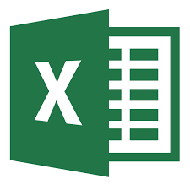
How to build a dashboard
You will need:
Excel
Google forms/charts

Slide 28
Where to start?
Take your CCC notes/charts/papers
Determine Key performance measures
LOGS
EVALS
Tests
Metrics

Slide 29
Milestone: Rotation evaluation indicators
Milestone: Project/Module completion

Slide 30
Dashboard help
Good Book
Information Dashboard Design
Stephen Few
Dashboard design optimization

Slide 31
Summary
NAS milestone management
Still a learning process at this point
Tools are available to make the data
Manageable
Interpretable
Customizable for your CCC needs

